Slide 1


Bank Loan Analysis
Presented by Group 4

Slide 2
Our Team
Sanjeevani Yadav
Monali Mate
Akshay Bangar
Firose Pasha
Mohammed Mirza Ahmed
Nishant Rane
Ashwin N

Slide 3
Introduction
The organization provided two finance Excel datasets, Finance 1 and Finance 2, containing financial information such as revenue, expenses, profit, and transaction details; the project focused on cleaning, combining, and analyzing the data using Microsoft Excel, Power BI, SQL, and Tableau to generate meaningful insights and dashboards.
📊 Power BI 📈 Tableau⚡ Excel 🗄️ SQL

Slide 4
Objectives
Created KPIs and performed analysis on:
💰Year-wise Loan Amount Statistics
💳 Grade & Sub-Grade wise Revolving Balance(revol_bal)revol_bal
📈Total Payment for Verified vs Non-Verified Status
🌍 State-wise and Month-wise Loan Status
🏠Home Ownership vs Last Payment Date Statistics

Slide 5
Planning the Analysis
  Reviewed finance data fields like loan amount, grade, payment status, and home ownership
  Organized and cleaned Finance 1 and Finance 2 datasets
  Combined both datasets into a single master dataset
  Used Microsoft Excel, SQL, Power BI, and Tableau for analysis and dashboard creation
  Planned dashboards to visualize financial trends and loan performance

Slide 6
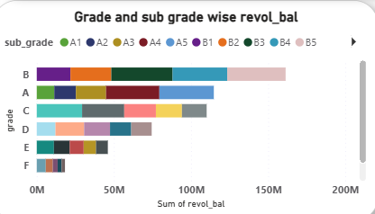
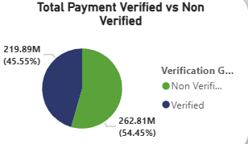
Dashboard

Slide 7
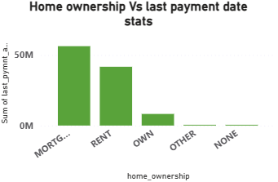
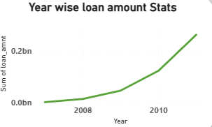
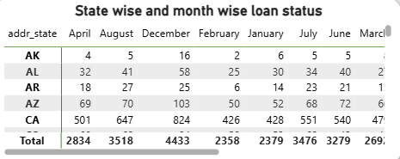

Slide 8

SQL Work
Loading Data
LOAD DATA INFILE '"C:\Program Files\MySQL\MySQL Server 8.0\Data\Finance_1.csv"'
INTO TABLE finance_1
FIELDS TERMINATED BY ','
OPTIONALLY ENCLOSED BY '"'
LINES TERMINATED BY '\r\n'
IGNORE 1 ROWS;
STATE WISE AND MONTH WISE LOAN STATUS
SELECT
addr_state,
COUNT(id) AS Total_Loans,
SUM(loan_amnt) AS Total_Loan_Amount
FROM finance_1
GROUP BY addr_state
ORDER BY Total_Loan_Amount DESC;

Slide 9
HOME OWNERSHIP ANALYSIS
SELECT
home_ownership,
COUNT(*) AS Total_Customers
FROM finance_1
GROUP BY home_ownership
ORDER BY Total_Customers DESC;
VERIFIED VS NON VERIFIED CUSTOMERS
SELECT
verification_status,
COUNT(*) AS Total_Customers
FROM finance_1
GROUP BY verification_status;
YEAR WISE LOAN TREND
SELECT
Year,
SUM(loan_amnt) AS Total_Loan_Amount
FROM finance_1
GROUP BY Year
ORDER BY Year;
TOP 10 HIGHEST LOANS
SELECT
id,
loan_amnt,
grade,
annual_inc
FROM finance_1
ORDER BY loan_amnt DESC
LIMIT 10;

Slide 10
Observation
  The bank’s loan amount and customer activity are increasing year by year.
  Verified customers contribute more to total payments and show better repayment behavior.
  Grade B and C customers have higher revolving balances and loan activity.
  Some states contribute more significantly to total loan distribution and customer engagement.
  Customers with mortgage ownership tend to make higher and more stable payments.

Slide 11
Suggestion
  Focus more on verified customers to reduce loan default risk.
  Improve credit assessment for low-performing customer groups.
  Introduce personalized banking offers based on customer behavior.
  Increase digital banking awareness and customer engagement.
  Use real-time analytics dashboards for continuous monitoring and better business decisions.

Slide 12
Conclusion
  The dashboard helps understand customer behavior, loan trends, and repayment performance effectively.
  Customer verification and credit grade have a strong impact on loan repayment reliability.
  Increasing loan and payment trends indicate business growth and strong customer participation.
  Power BI dashboards help convert raw banking data into meaningful business insights.
  Data analytics can support better decision-making, risk management, and customer service improvement.

Slide 13
Thank
You

